Slide 1

Indian Institute of Information Technology Kalyani
6th Semester Project (CS – 691)
DIABETIC RETINOPATHY DETECTION
Mentored By – Mr. Anirban Lakshman

Slide 2
MEMBERS
Akash Ramanand Rajak 435 19008
Amaan Khan 438 19011
Pallav Dubey 481 19054
Kumar Saurabh 470 19043

Slide 3
What is Diabetic Retinopathy?
Diabetic retinopathy, also known as diabetic eye disease (DED), is a medical condition in which damage occurs to the retina due to diabetes.
It is a leading cause of blindness in developed countries.
It's a diabetic complication that affects eyes, caused by damage to the blood vessels of the light sensitive tissue at the back of the eye (retina).
It also affects up to 80 % of those who have had diabetes for >= 20 years.

Slide 4
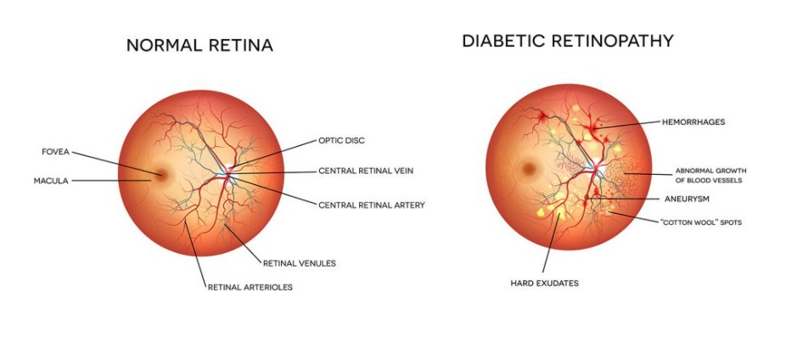
Sign and Symptoms
Diabetes is the common symptom in all patients.
Development of dark spots, blurred vision, empty areas in the vision
Vision disorder and difficulty in perceiving colours.

Slide 5
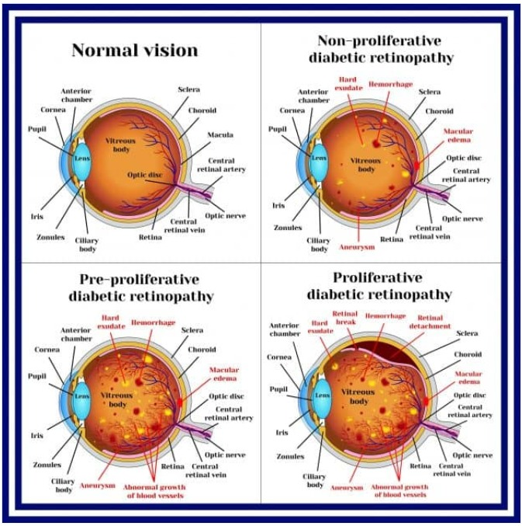
Stages and how they look like

Slide 6
Why this topic?
There are about 422 million diabetic patients across the world and we even can’t determine how many of them are suffering from diabetic retinopathy.
There is so much technology which have been invented for our comfort, good health and well being.
But the problem is that these technologies could be only afforded by financially sound people. The rest remains untreated without any good report because of lack of technology.
Therefore, propose a model which could identify a specific type of disease and classify them on their severity level and give a quick report to the doctor without taking time and money for its analysis.

Slide 7
Our Objective
To create a model which classifies between different types of diabetic retinopathy patient eye ball images, learn to classify, and make future classifications based on new data provided with as high accuracy as possible.
The model will take the input images of Retina and give the interpretation as one of the four stages of Diabetic Retinopathy.
Mild Non-proliferative Retinopathy
Moderate Non-proliferative Retinopathy
Severe Non-proliferative Retinopathy
Proliferative Retinopathy

Slide 8
Why Need of a Model?
A must need of an automatized model in medical is due to poor Doctor-Patient ratio.
In India, the this Ratio is 1 : 834.
Apart from this ratio, the specialists for specific medical queries such as DR are also lacking.
The result of detection process of DR patient takes long time due to multiple steps of medical processes and above stated problems.
So we need a model that will help to detect the DR in a more fast, efficient and accurate way.

Slide 9
Workflow
We have designed workflow for the identification, organization, and coordination of a particular set of tasks to produce our desired outcome.
We will follow the workflow of the project as follows.
Dataset finding for the model
Data preprocessing and modifications
model creation
model training on training dataset
model testing on test dataset
predicting on new input data and analyzing the result
wrapping everything in GUI interface

Slide 10
Tools/Technologies used
Python
Image Understanding and processing
Machine Learning
Python’s Sklearn library
Some other useful python libraries

Slide 11
Implementation
First we took the database of left and right retina images from Kaggle website.
The dataset contains approximately 35,000 pairs of retina images.
Using this as dataset, we created a model using machine learning algorithms and techniques.
For model, we used the two popular model, one is SVC(Support vector Classifier) and the another one is KNN(K – Nearest Neighbour).

Slide 12
Model Creation
The first algorithm that we used for model creation is SVC(Support vector classifier.)
SVC is a nonparametric clustering algorithm that does not make any assumption on the number or shape of the clusters in the data.
The objective of a Linear SVC (Support Vector Classifier) is to fit to the data you provide, returning a "best fit" hyperplane that divides, or categorizes, your data. From there, after getting the hyperplane, you can then feed some features to your classifier to see what the "predicted" class is..

Slide 13
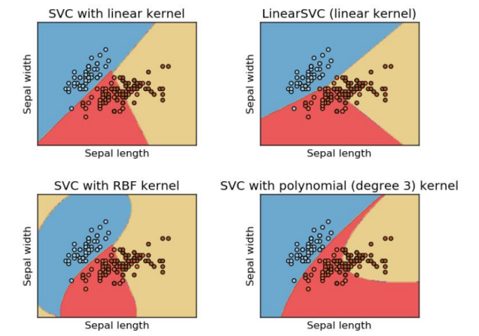
This is how SVC algorithm looks like:

Slide 14
The 2nd algorithm that we used is KNN(K – Nearest Neighbours) algorithm.
KNN algorithm is a simple, supervised machine learning algorithm that can be used to solve both classification and regression problems.
It’s easy to implement and understand, but has a major drawback of becoming significantly slow as the size of the data grows larger.
K-NN algorithm assumes the similarity between the new case/data and the available cases and put the new case into the category that is most similar to the available categories.
It is also a lazy learner algorithm because it does not learn from the training set immediately instead stores the dataset and at the time of classification, it performs the action on the dataset.

Slide 15
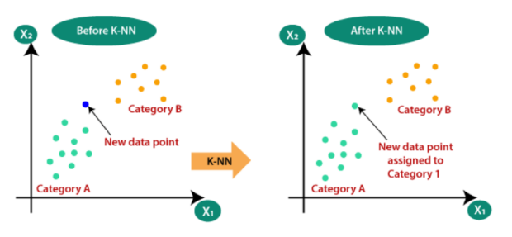
This is how KNN algorithm looks like:

Slide 16
Accuracy
The accuracy that we got from the trained model
First SVC – 96.62%
Second KNN – 94.38%
The reason for accuracy difference between both algorithm is beacuse SVM is less computationally demanding than KNN and is easier to interpret but can identify only a limited set of patterns.
Due to this accuracy difference we have retained SVC algorithm for our model.

Slide 17
GUI Configuration
After the model creation, we created a GUI configuration using tkinter library of python.
Using this GUI, we tested the images from the local system and detected whether there is DR or not .
GUI is formed in such a way :
User will be asked to select the left and corresponding right retina images of eye and then go for the detection part.

Slide 18
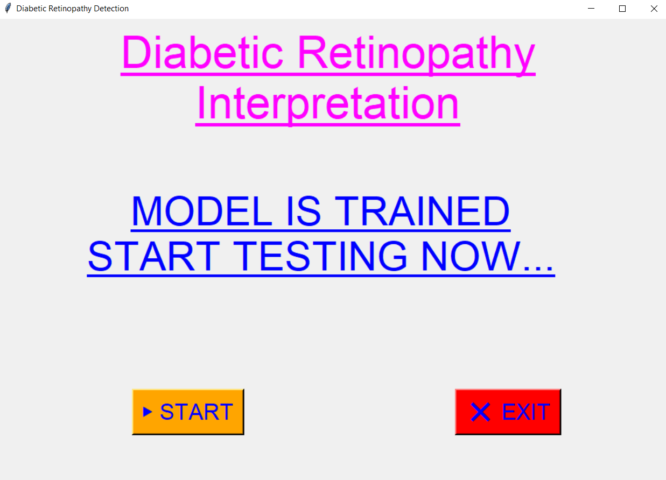

Slide 19
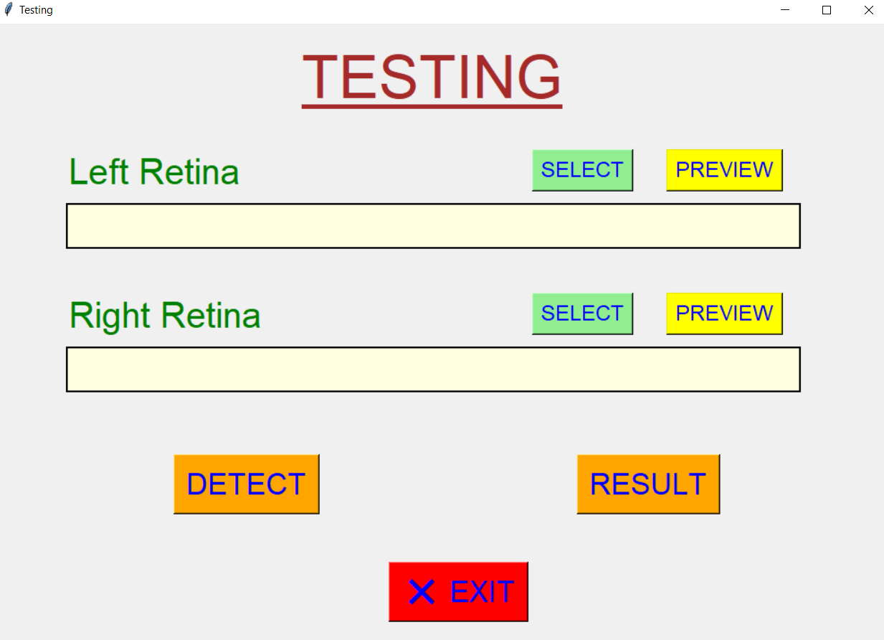

Slide 20
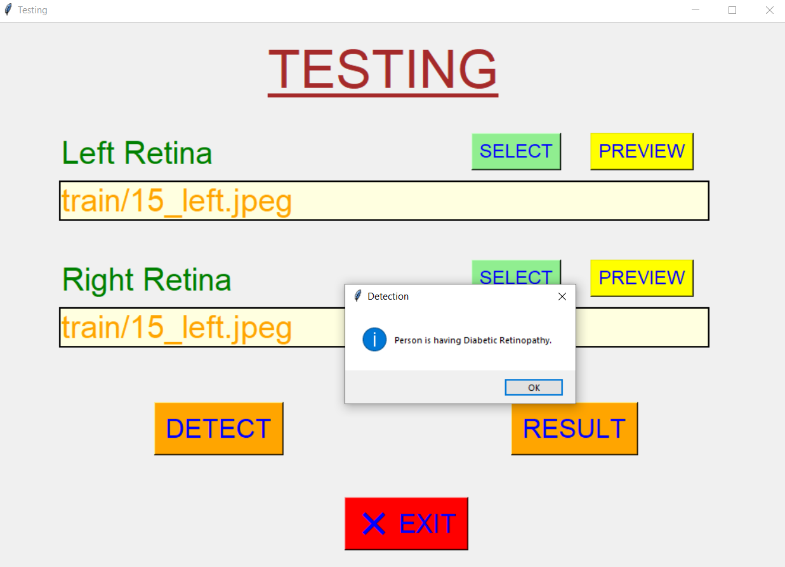

Slide 21
We implemented the Result button in the GUI configuration.
Since we know that there are mainly four stages of Diabetic Retinopathy:
Mild Non-proliferative Retinopathy
Moderate Non-proliferative Retinopathy
Severe Non-proliferative Retinopathy
Proliferative Retinopathy
So we implemented in such a way, that after detecting whether there is DR or not, it will assign levels to each of the pairs of retina images.
1 – level, 2 – level, 3 – level , 4 – level
And each level corresponds to each of the type of DR. And in that way we found out the type of DR for selected pairs of retina images.

Slide 22
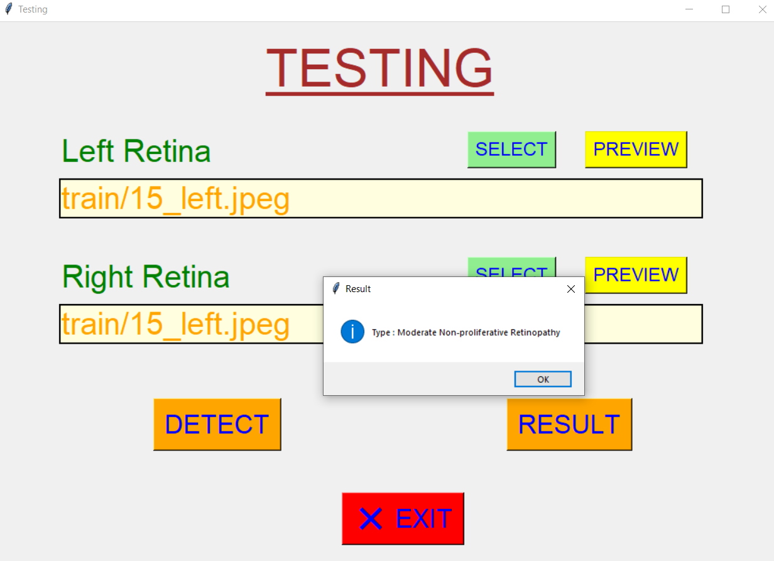

Slide 23
Till last week we implemented the testing GUI where we need to select both retina images.
Now we have updated the code, so that it will work even when we select at least one retina image.
For eg.) if we select only left retina image, in the result it will show that right image is not selected, and it will detect if left retina is defected by DR or not.
Same for the vice versa.
And if one selects both the pair of retina , then in result it will show, the result in form of type of DR with which left retina is defected and same for the right retina.

Slide 24
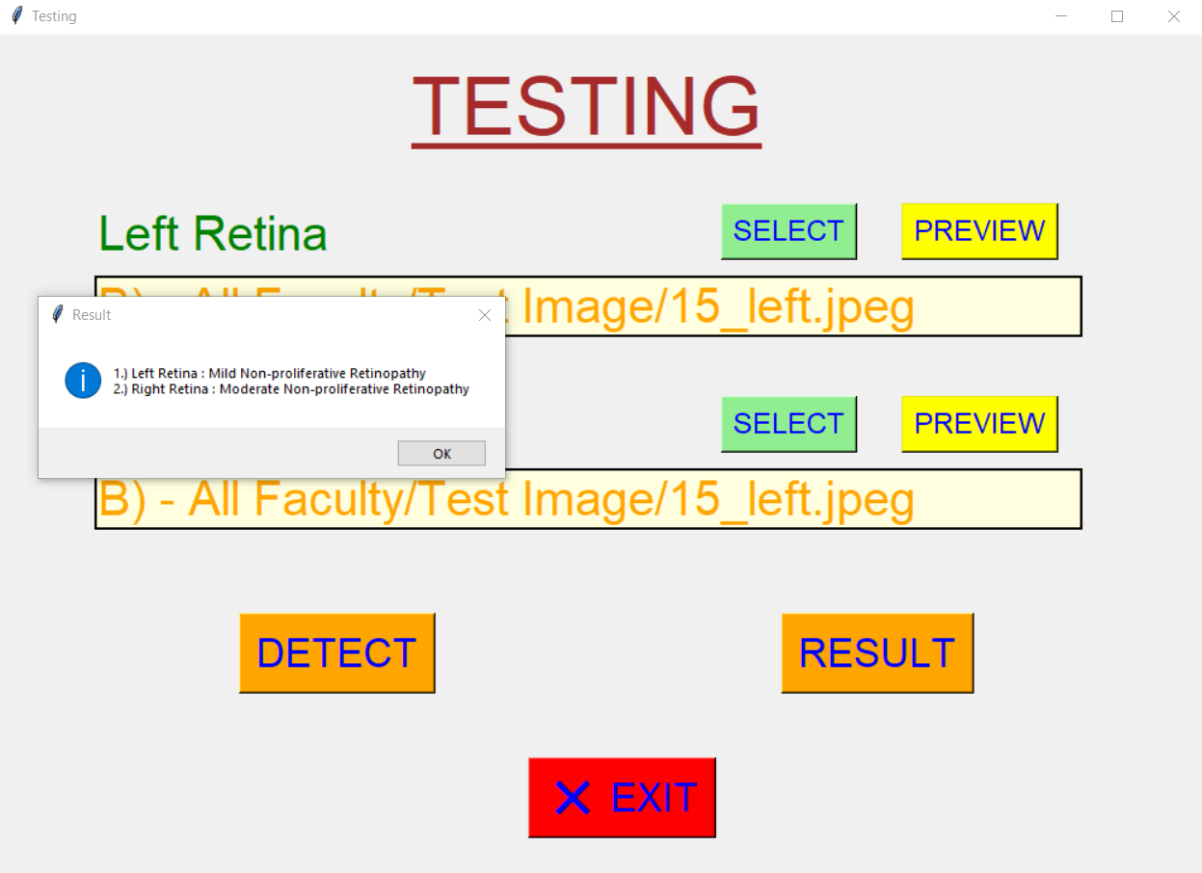

Slide 25
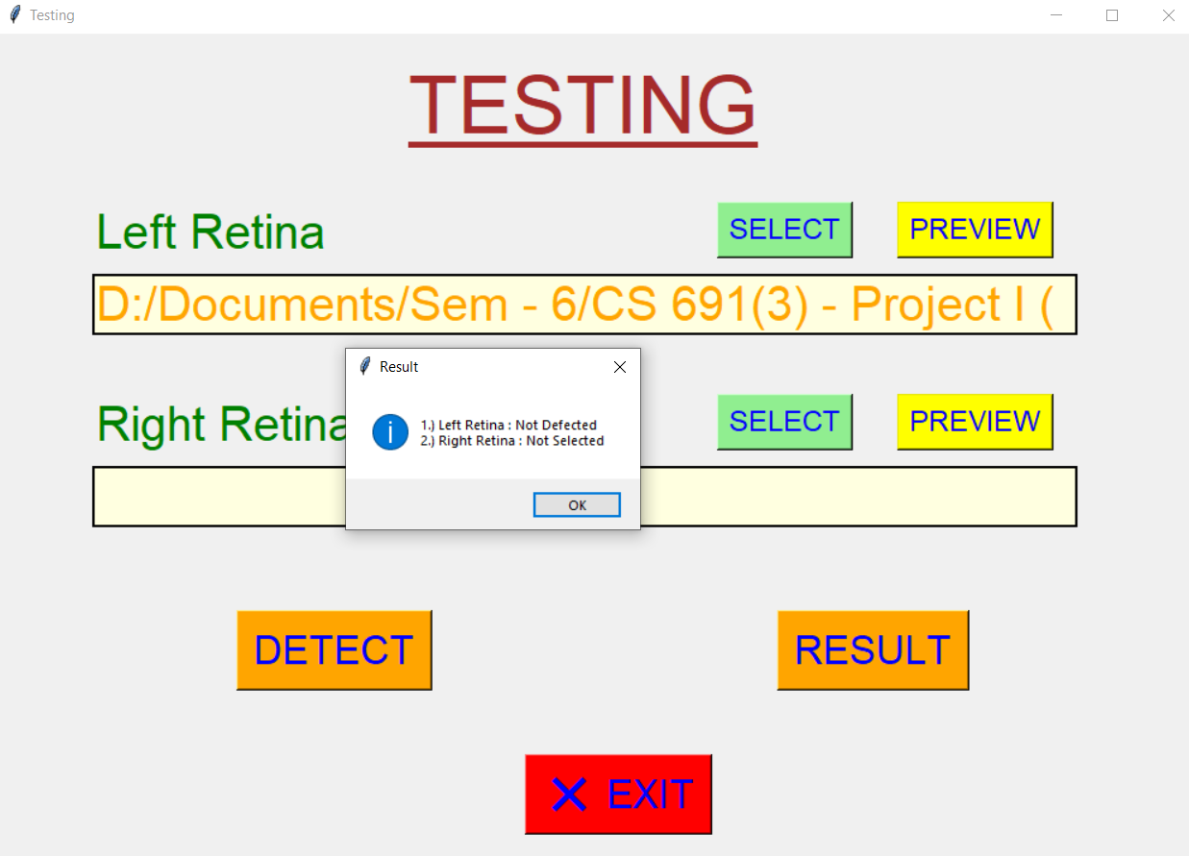

Slide 26
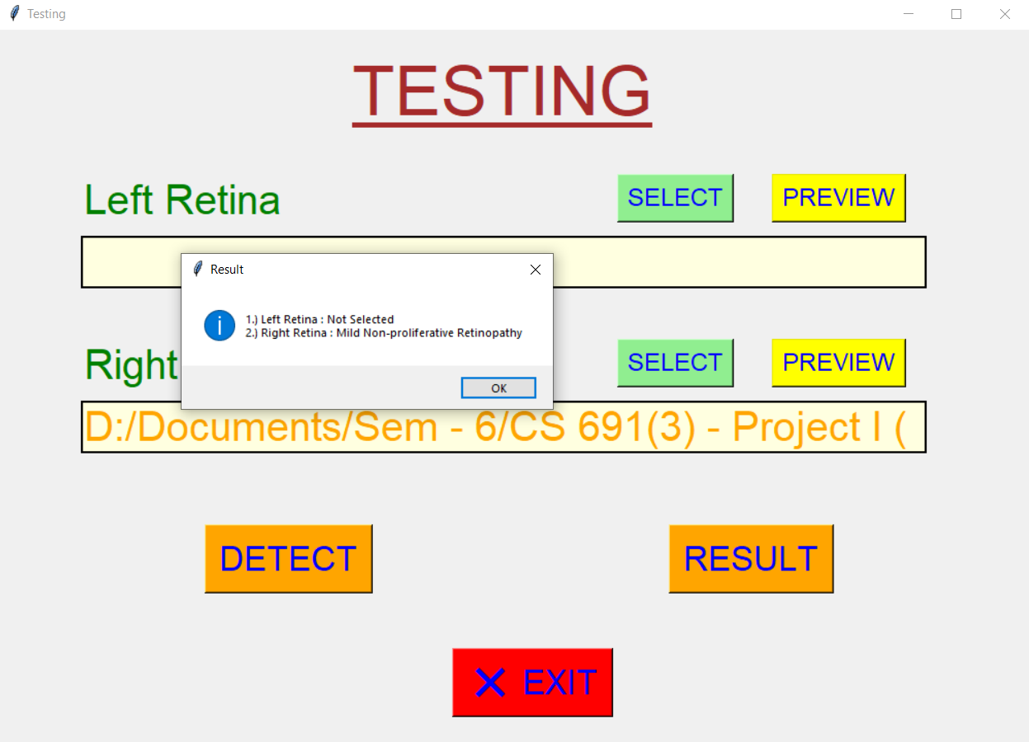

Slide 27
Conclusion and Future Scope
With the use of the Model, A medical organization can automate the health related queries without any hassle and process a large number of queries at once.
Assistants of Doctors can use the model to serve the patients of Diabetic Retinopathy.
Even a naïve person can use it for their own purpose after being consulted by a certified medical practitioner.
Conclusively, implementing this model in real life will be of great help.

Slide 28
References
[1] Programming Computer Vision with Python, 1st Edition, Jan Eric Solem, 2012, O’ Reily
[2] Learning OpenCv, Adrian Kaehler and Gary Rost Bradski, 2008, O’ Reily
[3] Data set – Kaggle (https://www.kaggle.com/datasets/tanlikesmath/diabeticretinopathy-resized?datasetId=131128&searchQuery=bin)
[4] Python GUI Programming with Tkinter, Alan D. Moore, 2018
[5] Python Standard Library, Fredrik Lundh, 2001, O’ Reily

Slide 29


